Slide 1
Introduction to AI Continued
Dr. Ajees A P
School of Computer Sciences
MG University

Slide 2
Human Intelligence
The quality of the mind to learn from past experience, adaptation to new situations, handling of abstract ideas and the ability to change his/her own environment using the gained knowledge.
Can provide observations during travel or other events.
Can provide data on things about which the person has specific knowledge, which can be another human subject, sensitive information, etc.

Slide 3
Agents
An agent is anything that can perceive its environment through sensors and acts upon that environment through effectors.
Artificial Intelligence is the study and design of Intelligent agents
An intelligent agent is a program that can make decisions or perform a service based on its environment, user input and experiences
Also called bots/robots

Slide 4
Advantages of Artificial Intelligence vs Human Intelligence
Speed of execution – While one doctor can make a diagnosis in ~10 minutes, AI system can make a million for the same time.
Less Biased – They do not involve Biased opinions on decision making process
Operational Ability – They do not expect halt in their work due to saturation
Accuracy – Preciseness of the output obviously increases

Slide 5
How do we measure if Artificial Intelligence is acting like a human?
Turing Test
The Cognitive Modelling Approach
The Law of Thought Approach
The Rational Agent Approach

Slide 6
Turing Test in Artificial Intelligence
The basis of the Turing Test is that the Artificial Intelligence entity should be able to hold a conversation with a human agent
To achieve this, AI needs to possess:
Natural Language Processing to communicate successfully.
Knowledge Representation to act as its memory.
Automated Reasoning to use the stored information to answer questions and draw new conclusions.
Machine Learning to detect patterns and adapt to new circumstances.

Slide 7
Cognitive Modelling Approach
Cognition involves conscious intellectual activity such as thinking, reasoning, or remembering
To distil the essence of the human mind, there are 3 approaches:
Introspection: observe thoughts and builds a model based on it
Psychological Experiments: conduct experiments on humans and observe the behaviour
Brain Imaging: Use MRI to observe how the brain functions in different scenarios and replicating that through code.

Slide 8
The Laws of Thought Approach
The Laws of Thought are a large list of logical statements that govern the operation of our mind.
The same laws can be codified and applied to artificial intelligence algorithms
The issues with this approach, because solving a problem in principle (strictly according to the laws of thought) and solving them in practice can be quite different, requiring contextual nuances to apply.

Slide 9
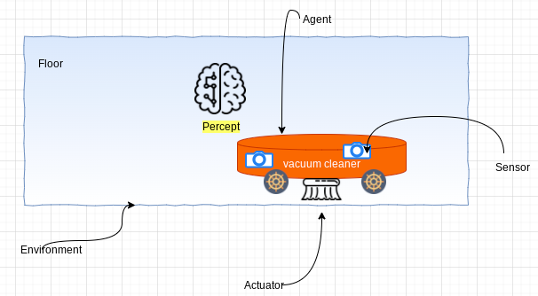
Rational agent
Any piece of software, hardware or a combination of the two which can interact with the environment with actuators after perceiving the environment with sensors.

Slide 10
The Rational Agent Approach
A rational agent acts to achieve the best possible outcome in its present circumstances.
According to the Laws of Thought approach, an entity must behave according to the logical statements
But there are some instances, where there is no logical right thing to do, with multiple outcomes involving different outcomes and corresponding compromises
The rational agent approach tries to make the best possible choice in the current circumstances.
It means that it’s a much more dynamic and adaptable agent.

Slide 11
What are the Types of Artificial Intelligence?
Artificial Narrow Intelligence (ANI)
Artificial General Intelligence (AGI)
Artificial Super Intelligence (ASI)

Slide 12
What is Artificial Narrow Intelligence (ANI)?
This is the most common form of AI that you’d find in the market now – Weak AI
These Artificial Intelligence systems are designed to solve one single problem and would be able to execute a single task really well. By definition, they have narrow capabilities, like recommending a product for an e-commerce user or predicting the weather
They’re able to come close to human functioning in very specific contexts, and even surpass them in many instances, but only excelling in very controlled environments with a limited set of parameters.

Slide 13
What is Artificial General Intelligence (AGI)?
AGI is still a theoretical concept – Strong AI
It’s defined as AI which has a human-level of cognitive function, across a wide variety of domains such as language processing, image processing, computational functioning and reasoning and so on. We’re still a long way away from building an AGI system
An AGI system would need to comprise of thousands of Artificial Narrow Intelligence systems working in tandem, communicating with each other to mimic human reasoning
Even with the most advanced computing systems and infrastructures, such as Fujitsu’s K or IBM’s Watson, it has taken them 40 minutes to simulate a single second of neuronal activity
This speaks to both the immense complexity and interconnectedness of the human brain, and to the magnitude of the challenge of building an AGI with our current resources.

Slide 14
What is Artificial Super Intelligence (ASI)?
We’re almost entering into science-fiction territory here, but ASI is seen as the logical progression from AGI – Strong AI
An Artificial Super Intelligence (ASI) system would be able to surpass all human capabilities
This would include decision making, taking rational decisions, and even includes things like making better art and building emotional relationships

Slide 15
(Contd..)
Once we achieve Artificial General Intelligence, AI systems would rapidly be able to improve their capabilities and advance into realms that we might not even have dreamed of
While the gap between AGI and ASI would be relatively narrow (some say as little as a nanosecond, because that’s how fast Artificial Intelligence would learn) the long journey ahead of us towards AGI itself makes this seem like a concept that lays far into the future.

Slide 16
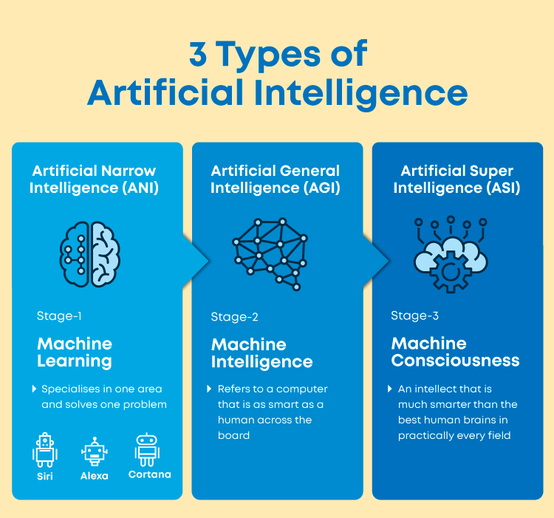

Slide 17
Difference between Augmentation and AI
Artificial Intelligence | Augmented Intelligence
AI replaces humans and operates with high accuracy. | Augmentation does not replace people but creates systems that help in manufacturing.
Replaces human decision making | Augments human decision making
Robots/Industrial IoT: Robots will replace all humans on the factory floor. | Robots/Industrial IoT: Collaborative robots work along with humans to handle tasks that are hard and repetitive.
Real-Time Applications of AI in Customer Success 1. Automated Customer Support and Chatbots 2. Virtual Assistants Automated Workflows | Real-Time Applications of IA in Customer Success 1. IA-enabled customer analytics 2. Discover high risk/high potential customers 3. Forecasts Sales

Slide 18
What are the four types of AI?
Reactive AI relies on real-time data to make decisions.
Limited Memory AI relies on stored data to make decisions.
Theory of Mind AI can consider subjective elements such as user intent when making decisions.
Self-Aware AI possesses a human-like consciousness that is capable of independently setting goals and using data to decide the best way to achieve an objective.

Slide 19
WHAT ARE EXAMPLES OF ARTIFICIAL INTELLIGENCE?
Siri, Alexa and other smart assistants
Self-driving cars
Robo-advisors
Conversational bots
Email spam filters
Netflix's recommendations

Slide 20
Types of artificial intelligence—weak AI vs. strong AI
Weak AI—also called Narrow AI or Artificial Narrow Intelligence (ANI)—is AI trained and focused to perform specific tasks
Weak AI drives most of the AI that surrounds us today. ‘Narrow’ might be a more accurate descriptor for this type of AI as it is anything but weak; it enables some very robust applications, such as Apple's Siri, Amazon's Alexa, IBM Watson, and autonomous vehicles.

Slide 21
Strong AI
Made up of Artificial General Intelligence (AGI) and Artificial Super Intelligence (ASI). Artificial general intelligence (AGI), or general AI, is a theoretical form of AI where a machine would have an intelligence equaled to humans; it would have a self-aware consciousness that has the ability to solve problems, learn, and plan for the future
Artificial Super Intelligence (ASI)—also known as superintelligence—would surpass the intelligence and ability of the human brain
While strong AI is still entirely theoretical with no practical examples in use today, that doesn't mean AI researchers aren't also exploring its development. In the meantime, the best examples of ASI might be from science fiction, such as HAL, the superhuman,etc.

